Slide 1



Mitron Bank: Analysis for New Credit Card Launch
View in Power BI

Slide 2
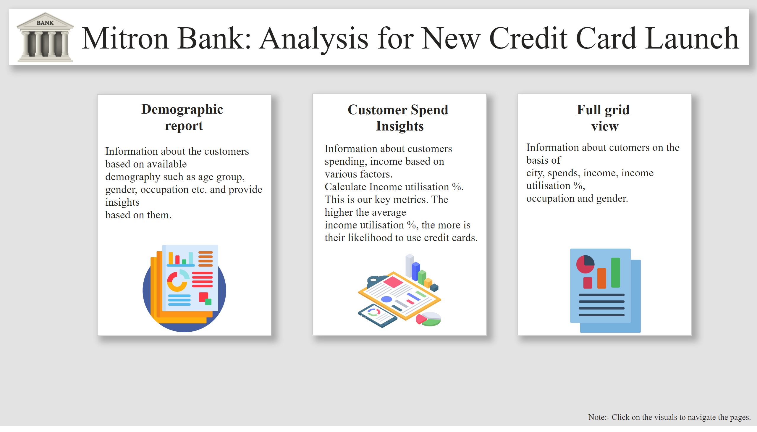
Home
Notes:
textbox
No alt text provided
textbox
No alt text provided
textbox
No alt text provided
shape
No alt text provided
textbox
No alt text provided
textbox
No alt text provided
shape
No alt text provided
textbox
No alt text provided
textbox
No alt text provided
shape
No alt text provided
image
No alt text provided
image
No alt text provided
image
No alt text provided
image
No alt text provided
textbox
No alt text provided

Slide 3
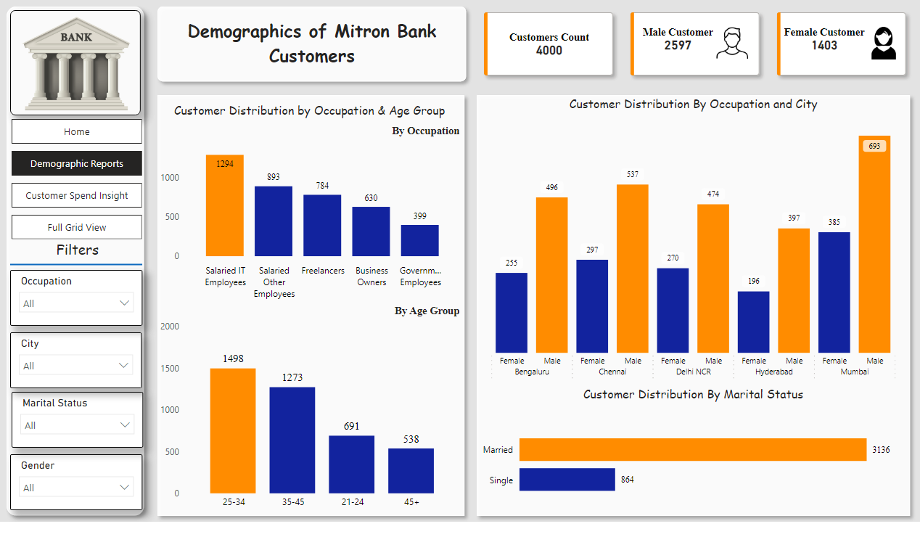
Demographic Reports
Notes:
textbox
No alt text provided
shape
No alt text provided
cardVisual
No alt text provided
textbox
No alt text provided
By Occupation
No alt text provided
By Age Group
No alt text provided
shape
No alt text provided
slicer
No alt text provided
image
No alt text provided
textbox
No alt text provided
shape
No alt text provided
slicer
No alt text provided
slicer
No alt text provided
slicer
No alt text provided
shape
No alt text provided
Customer Distribution By Marital Status
No alt text provided
Customer Distribution By Occupation and City
No alt text provided
shape
No alt text provided
pageNavigator
No alt text provided

Slide 4
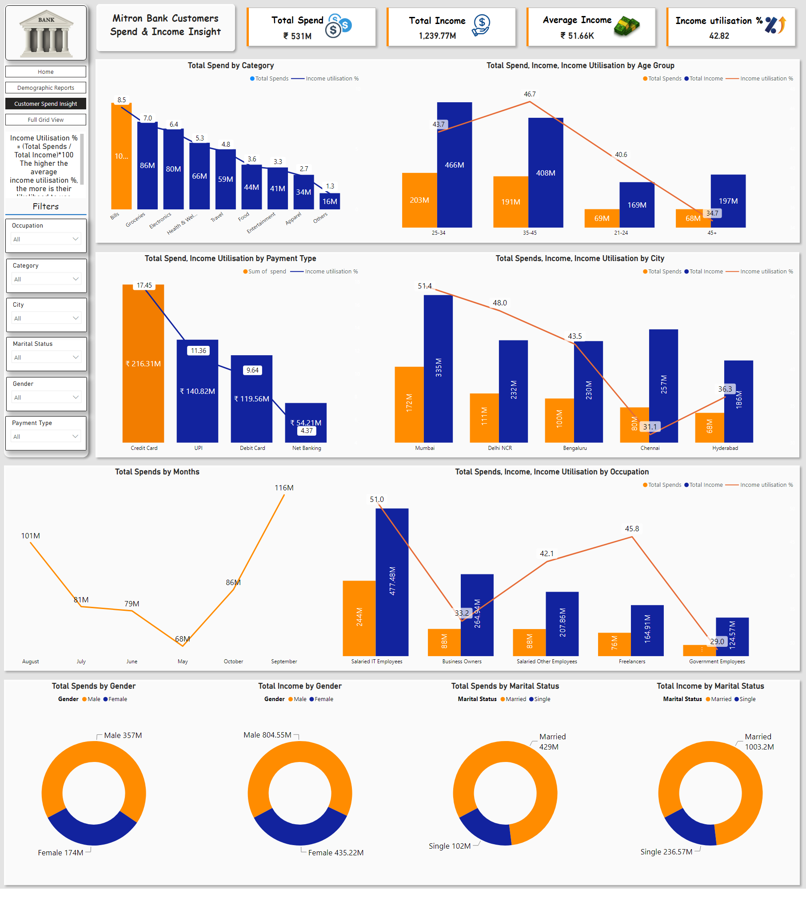
Customer Spend Insight
Notes:
textbox
No alt text provided
shape
No alt text provided
cardVisual
No alt text provided
Total Spend, Income Utilisation by Payment Type
No alt text provided
Total Spends, Income, Income Utilisation by City
No alt text provided
Total Spend by Category
No alt text provided
Total Spend, Income, Income Utilisation by Age Group
No alt text provided
shape
No alt text provided
shape
No alt text provided
Total Spends by Gender
No alt text provided
Total Income by Gender
No alt text provided
Total Spends by Marital Status
No alt text provided
Total Income by Marital Status
No alt text provided
shape
No alt text provided
Total Spends, Income, Income Utilisation by Occupation
No alt text provided
Total Spends by Months
No alt text provided
shape
No alt text provided
pageNavigator
No alt text provided
textbox
No alt text provided
slicer
No alt text provided
image
No alt text provided
textbox
No alt text provided
shape
No alt text provided
slicer
No alt text provided
slicer
No alt text provided
slicer
No alt text provided
slicer
No alt text provided
slicer
No alt text provided
shape
No alt text provided

Slide 5
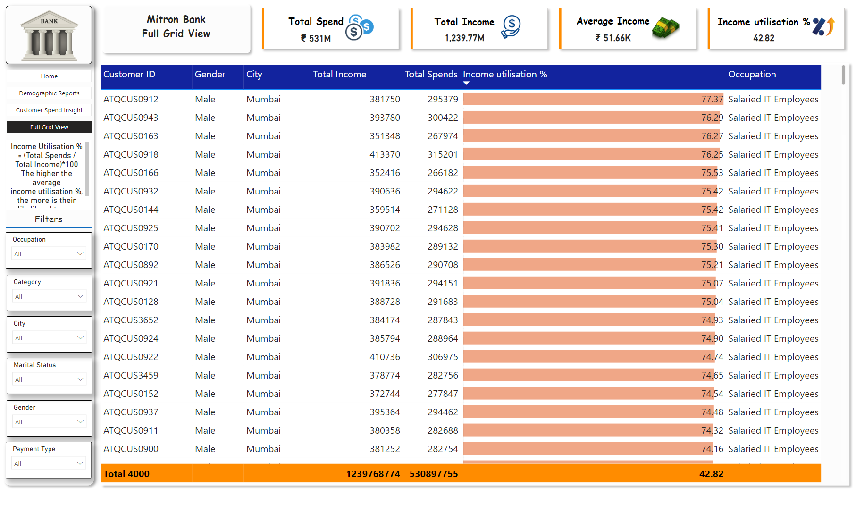
Full Grid View
Notes:
cardVisual
No alt text provided
pageNavigator
No alt text provided
textbox
No alt text provided
shape
No alt text provided
slicer
No alt text provided
image
No alt text provided
textbox
No alt text provided
shape
No alt text provided
slicer
No alt text provided
slicer
No alt text provided
slicer
No alt text provided
slicer
No alt text provided
slicer
No alt text provided
shape
No alt text provided
Total Spend, Income, Income Utilisation by Age Group
No alt text provided
shape
No alt text provided
textbox
No alt text provided

